Slide 1

PetMind Sales Report
By: Segun umoru

Slide 2

Background
Problem Statement
Insights and Observations
Business Recommendations

Slide 3

Background
PetMind is a retailer of products for pets. They are based in the United States. PetMind sells products that are a mix of luxury items and everyday items. Luxury items include toys. Everyday items include food.

Slide 4

The company wants to increase sales by selling more everyday products repeatedly. They have been testing this approach for the last year. They now want a report on how repeat purchases impact sales

Slide 5
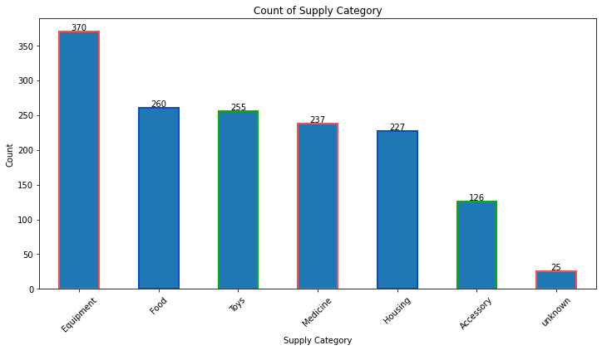
Supply Category Distribution
The report presents a summary of the number of items sold in different categories. The Equipment category had the highest number of items sold at 370 units, followed by Food, Toys, Medicine, Housing, Accessories, and an unknown category. The report suggests that customers are more interested in purchasing equipment items, followed by food and toys. The Medicine and Housing categories have a lower number of items sold, while the Accessory category has the lowest number of items sold.

Slide 6
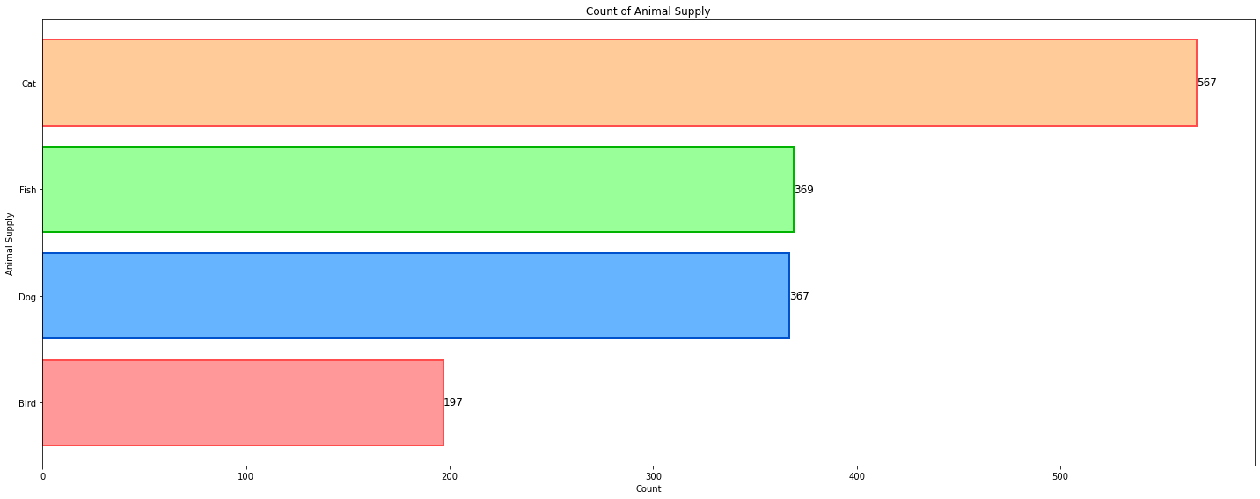
Animal Supply Distribution
It shows the number of animals owned by customers in different categories, with the highest number of animals owned in the `Cat category at 567 units`. This is followed by Fish at 369 units, Dog at 367 units, and Bird at 197 units.
The Cat category appears to be the most popular among customers, with a significantly higher number of cats owned compared to other types of animals. This suggests that customers may prefer cats as pets over other types of animals.*
The Fish and Dog categories have a relatively high number of animals owned in each category, which suggests that customers may value fish and dogs as popular choices for pets as well.
The Bird category has the lowest number of animals owned, which suggests that customers may be less interested in owning birds as pets.

Slide 7
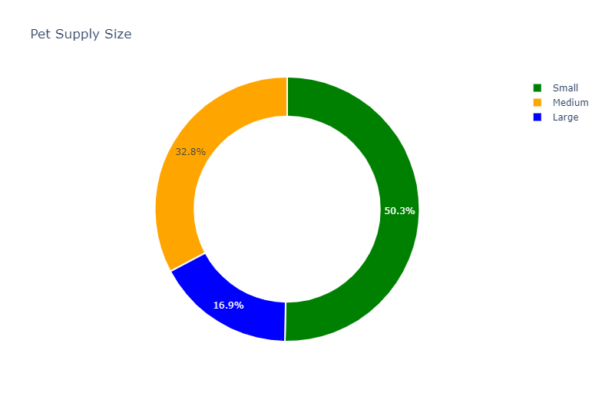
Pet Supply Size Distribution
It shows the distribution of items sold in different size categories, with the highest number of items sold in the Small category at 754 units. This is followed by Medium at 492 units and Large at 254 units.
The Small category appears to be the most popular among customers, with a significantly higher number of small-sized items sold compared to medium and large-sized items. This suggests that customers may prefer smaller-sized items for various reasons, such as affordability, convenience, or portability.
The Medium category has a relatively high number of items sold, which suggests that customers may value medium-sized items as well.
The Large category has the lowest number of items sold, which suggests that customers may be less interested in purchasing large-sized items.

Slide 8
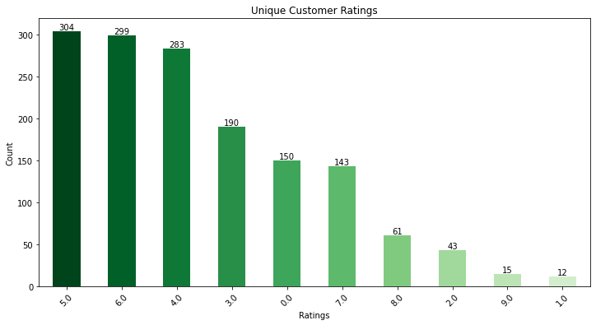
Unique Customer Ratings
It shows the distribution of ratings given by customers, with the highest number of ratings at 5.0 and 6.0, at 304 and 299 respectively. The next most common rating is 4.0, with 283.
It also shows that there are a relatively low number of ratings at the extremes of the scale, with only 12 ratings at 1.0 and 15 ratings at 9.0.
This suggests that customers tend to rate products or services in the middle of the scale, with ratings of 4.0, 5.0, and 6.0 being the most common. It may also suggest that customers are generally satisfied with the products or services they are rating, as there are relatively few ratings at the low end of the scale.

Slide 9
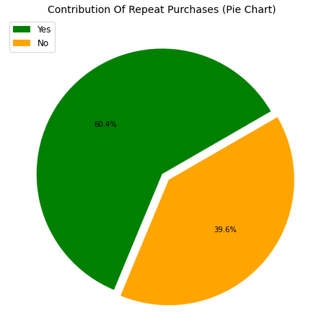
Distribution of Repeat Purchases
It shows the number of repeat purchases made by customers, with 60.4% of customers making repeat purchases and 39.6% of customers not making repeat purchases.
This suggests that a significant portion of customers are making repeat purchases, which is a positive indication of customer loyalty and satisfaction. Businesses can leverage this information to identify loyal customers and offer them incentives or rewards to encourage further repeat purchases.

Slide 10
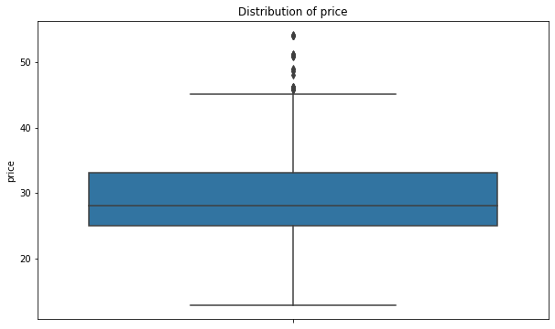
Summary Statistics of Price
It shows the summary statistics of the 'price’ variable, which includes 1500 observations. The mean price is $29, which indicates that the average price of the items in the dataset is $29. The standard deviation of the prices is $7, which suggests that there is some variability in the prices of the items.
The minimum price is $12, which is the lowest price observed in the dataset. The 25th percentile is $25, which means that 25% of the items have a price of $25 or lower.
The median price is $28, which indicates that half of the items have a price lower than 28 and half have a price higher than 28. The 75th percentile is $33, which means that 75% of the items have a price of $33 or lower. The maximum price is $54, which is the highest price observed in the dataset.

Slide 11
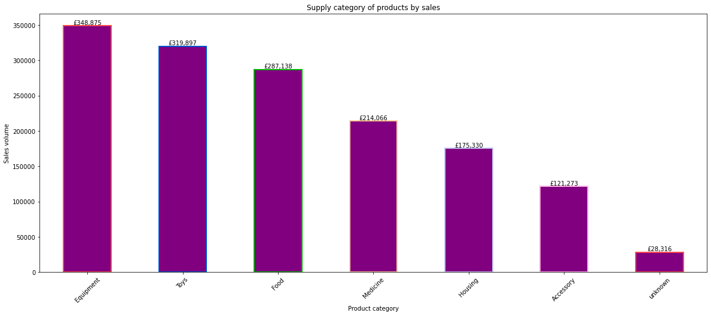
Supply Category By Sales
It shows the total sales for different categories, with the highest sales in the Equipment category at `348,875.24 pounds`. This is followed by Toys at `319,897.10 pounds` and Food at `287,138.16 pounds`.
The data also shows that there is a significant difference in sales between categories, with the lowest sales in the Accessory and Unknown categories at 121,273.44 and 28,316.27 pounds respectively.
This suggests that businesses operating in the Equipment, Toys, and Food categories have a higher potential for generating revenue compared to businesses operating in the other categories.

Slide 12
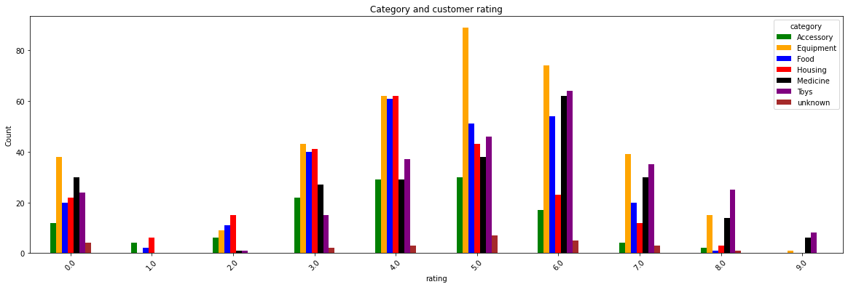
Category And Customer Rating
The highest number of ratings in most categories is at the 5.0 and 6.0 rating levels, with some exceptions. This suggests that customers tend to rate products or services in the middle of the scale, indicating that they are generally satisfied with their purchases.
The number of ratings generally decreases as we move towards the extremes of the scale, with relatively few ratings at the lowest and highest levels. This may suggest that customers are less likely to rate products or services when they are extremely satisfied or dissatisfied.

Slide 13
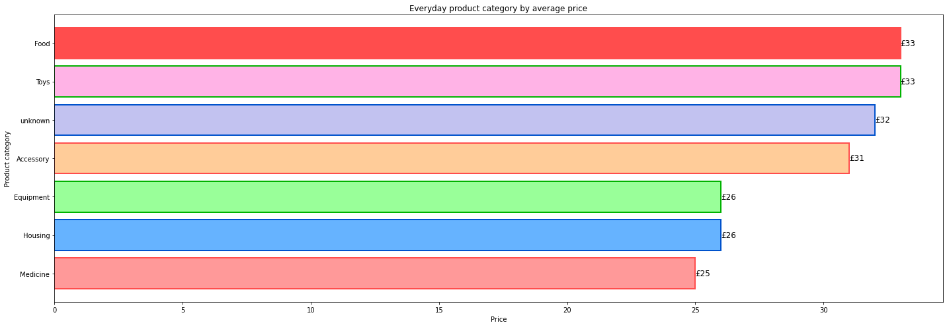
Category By Average Price
It shows the number of items available in different categories, with the highest number of items available in the Food and Toys categories at £33 each. This is followed by the unknown category at £32 and the Accessory category at £31.
The Medicine, Housing, and Equipment categories have relatively lower numbers of items available, with £25, £26, and £26 respectively. This suggests that businesses operating in the Food and Toys categories have a higher potential for generating revenue compared to businesses operating in the other categories due to the higher number of items available.

Slide 14
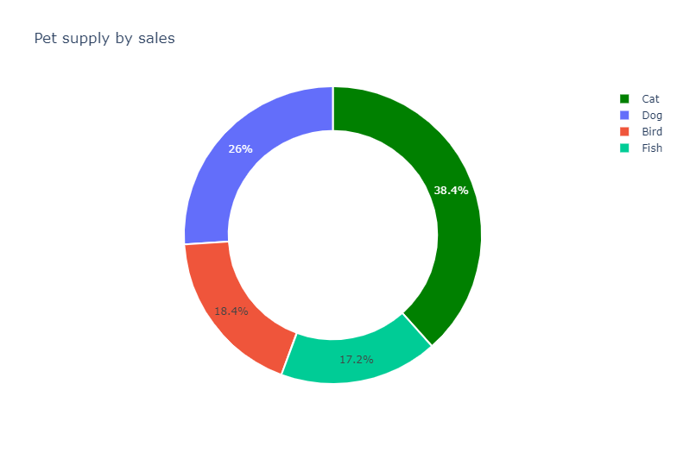
Animals By Sales
It shows the total sales for different animal categories, with the highest sales in the Cat category at £574,232.13. This is followed by the Dog category at £388,405.75, the Bird category at £274,999.99, and the Fish category at £257,258.90.
This suggests that businesses operating in the Cat and Dog categories have a higher potential for generating revenue compared to businesses operating in the Bird and Fish categories. It also highlights the importance of understanding customer preferences and demand when developing product assortments and pricing strategies.

Slide 15
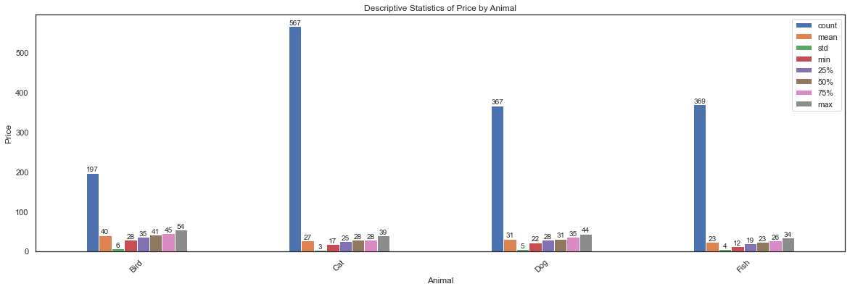
Summary Statistics of Price By Animal
The Cat category has the highest count at 567, indicating that there are more items in this category compared to the other categories. The Bird category has the highest mean price at £40, followed by the Dog category at £31, the Cat category at £27, and the Fish category at £23. The Bird category also has the highest standard deviation at £6, indicating that there is more variability in prices within this category compared to the other categories.
The Fish category has the lowest minimum price at £12, indicating that there are some items in this category that are priced lower than items in the other categories.

Slide 16
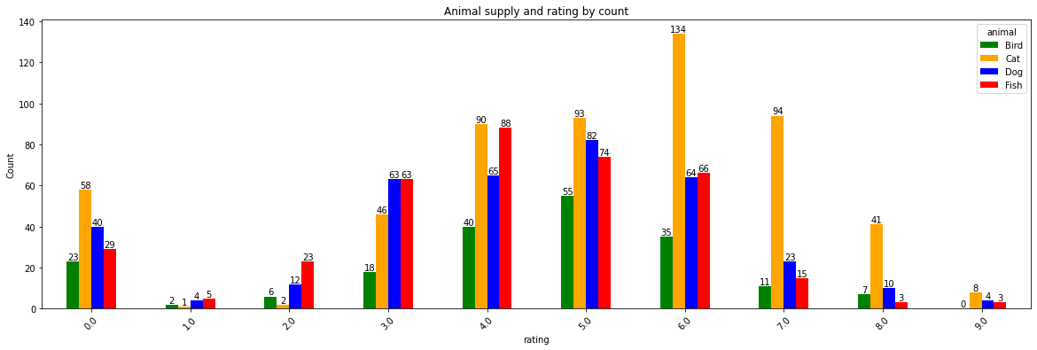
Animal By Rating
The highest number of ratings in most categories is at the 5.0 rating level, with some exceptions. This suggests that customers tend to rate products or services positively.
The number of ratings generally decreases as we move towards the extremes of the scale, with relatively few ratings at the lowest and highest levels. This may suggest that customers are less likely to rate products or services when they are extremely satisfied or dissatisfied.

Slide 17
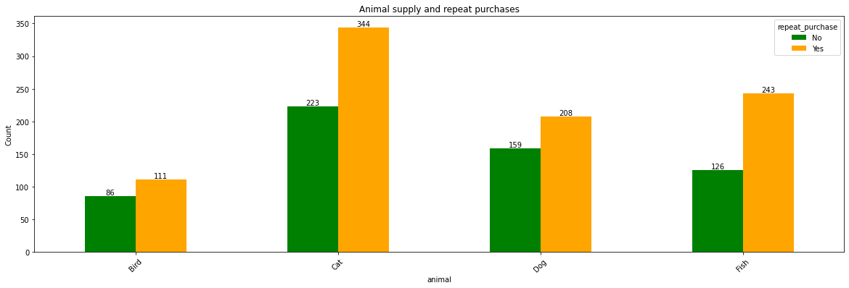
Animal By Repeat Purchases
The Cat category has the highest number of repeat purchases, with 344 customers making a repeat purchase and 223 customers not making a repeat purchase. The Dog category has the second highest number of repeat purchases, with 208 customers making a repeat purchase and 159 customers not making a repeat purchase.
The Fish category has the third highest number of repeat purchases, with 243 customers making a repeat purchase and 126 customers not making a repeat purchase. The Bird category has the lowest number of repeat purchases, with 111 customers making a repeat purchase and 86 customers not making a repeat purchase.

Slide 18
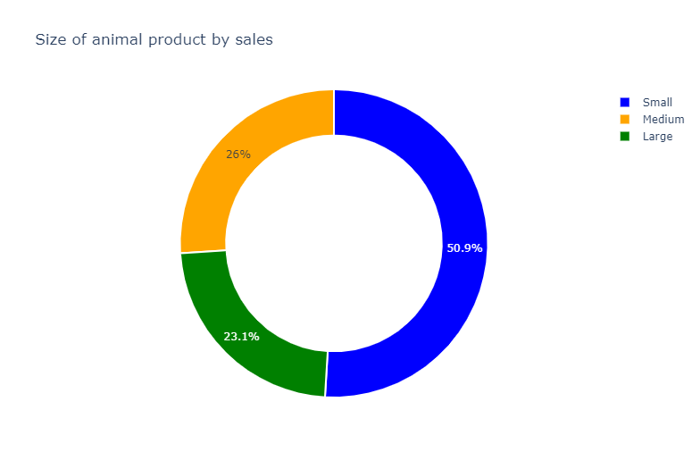
Size of Animal By Sales
It shows the total sales for different size categories, with the highest sales in the Small size category at £761,295.55. This is followed by the Medium size category at £388,952.41 and the Large size category at £344,648.81.
This suggests that businesses catering to the Small size category have the highest potential for generating revenue, followed by the Medium and Large size categories.

Slide 19
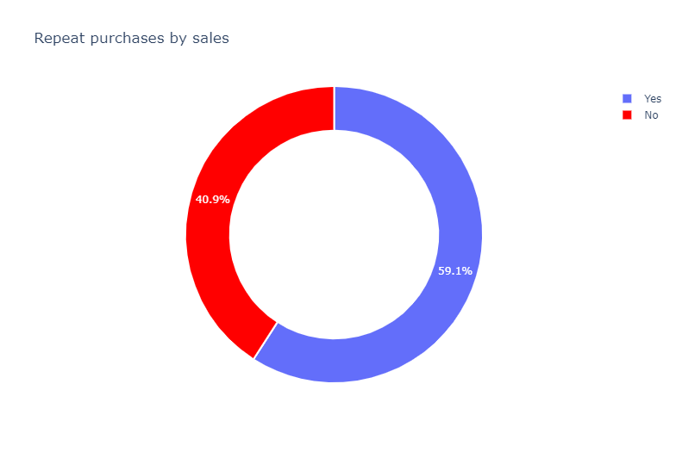
Repeat Purchases By Sales
Customers who made repeat purchases generated a total of £884,046.17 in sales.
Customers who did not make repeat purchases generated a total of £610,850.60 in sales.
This highlights the importance of customer retention and loyalty in generating revenue for businesses. By encouraging repeat purchases and developing strategies to retain customers, businesses can increase their sales and profitability.

Slide 20
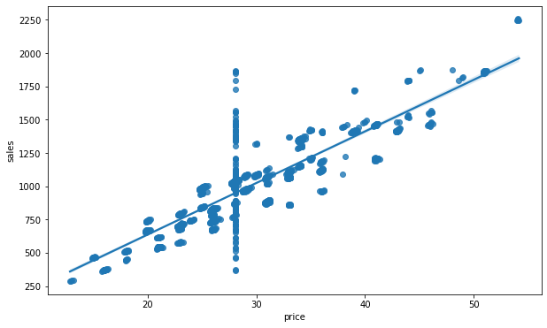
Relationship Between Sales And Price
The Pearson correlation coefficient of 0.878 suggests a strong positive linear relationship between the sales and price variables. This means that as the price increases, the sales also tend to increase.

Slide 21
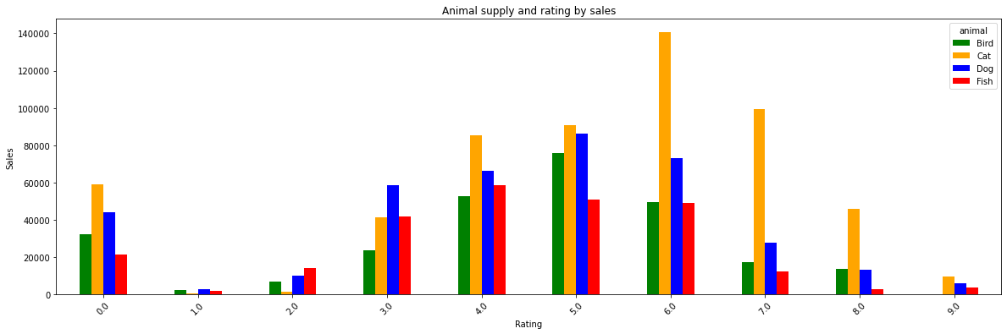
Animal And Rating By Sales
The Cat category has the highest sales in most rating levels, except for the 0.0 and 5.0 rating levels where the Bird category has the highest sales.
The Fish category has the lowest sales in most rating levels, except for the 2.0 and 3.0 rating levels where the Bird category has the lowest sales.
Sales generally increase as we move towards higher rating levels, with some exceptions. For example, the 5.0 rating level has lower sales than the 4.0 rating level in the Fish category.

Slide 22
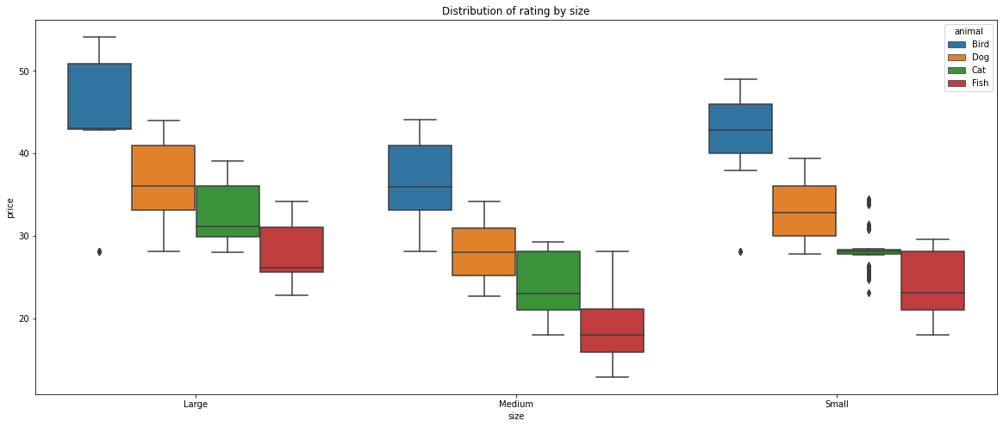
Animal And Size By Average Price
The Bird category has the highest average price with a value of 42, 38, and 45 cross the Large, Medium, and Small of the size.
The Fish is the least category among the Pets with average price of 25, 20, and 22 across the Large, Medium and Small size respectively.

Slide 23
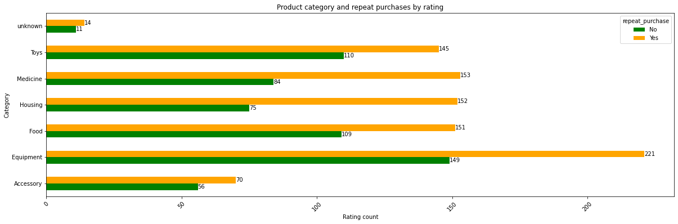
Category And Repeat Purchase By Rating
The Equipment category has the highest number of repeat purchases, with 221 customers making a repeat purchase and 149 customers not making a repeat purchase. The Medicine category has the second highest number of repeat purchases, with 153 customers making a repeat purchase and 84 customers not making a repeat purchase.
The Food and Housing categories also have a relatively high number of repeat purchases, with 151 and 152 customers making a repeat purchase, respectively.
The Accessory, Toys, and unknown categories have a lower number of repeat purchases compared to the other categories.

Slide 24
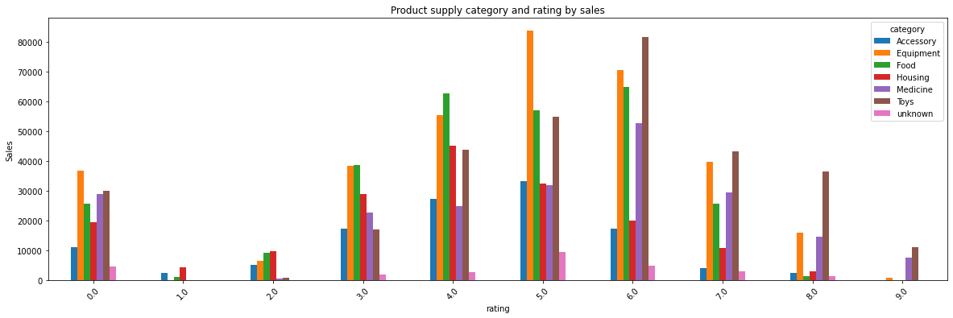
Category And Rating By Sales
The Equipment category has the highest sales in most rating levels, except for the 0.0, 1.0, and 5.0 rating levels where the Toys category has the highest sales.
The Food category has the lowest sales in most rating levels, except for the 1.0 rating level where the Accessory category has the lowest sales.
Sales generally increase as we move towards higher rating levels, with some exceptions. For example, the 5.0 rating level has lower sales than the 4.0 rating level in the Housing category.

Slide 25

Business Recommendations
Inventory Management and Supply Chain Optimization: Given that the majority of transactions involve small quantities of products, businesses should focus on optimizing their inventory management. This includes ensuring adequate stock levels for products with median or below-median quantities (e.g., 3 or lower) while avoiding overstocking.
Pricing Strategies: The wide variation in unit prices suggests that businesses should adopt flexible pricing strategies that reflect the diversity of their product offerings. Consider pricing adjustments based on factors such as product category, brand, and customer segment to maximize profitability.
Customer-Centric Marketing and Sales: As sales amounts vary widely, businesses should adopt marketing and sales strategies tailored to customer preferences. Customer segmentation and targeted marketing campaigns can help maximize sales and revenue.
Category-Based Marketing: Focus marketing efforts on popular categories like Equipment, Food, and Toys. Allocate resources efficiently based on customer demand and prioritize product development or promotions in these categories.
Pet Category Insights: Acknowledge the popularity of cats as pets and consider offering a wider range of cat-related products. Additionally, invest in understanding the needs and preferences of customers who own dogs, fish, and birds to tailor product offerings accordingly.
Size Category Considerations: Recognize that smaller-sized items are preferred by customers, likely due to factors like affordability and convenience. Develop or highlight small-sized products in your offerings and marketing efforts.

Slide 26

Customer Loyalty Programs: Leverage the high percentage (60.4%) of repeat purchases to establish customer loyalty programs. Reward loyal customers with incentives or discounts to encourage further repeat purchases.
Product Pricing and Assortment: Analyze the correlation between sales and price (0.878). Consider adjusting pricing strategies to maximize sales while ensuring profitability.
Ratings and Customer Feedback: Although customers tend to rate products in the middle of the scale, analyze lower ratings (1.0 and 2.0) to identify areas for improvement. Consider soliciting more feedback and reviews to enhance product quality and customer satisfaction.
Category-Specific Retention Strategies: Develop category-specific customer retention strategies, especially for Equipment, Medicine, Food, and Housing categories, where customers are more likely to make repeat purchases.
Optimizing Product Sizes: Recognize that Large and Small size categories have the highest percentage of customers making repeat purchases. Consider optimizing product sizes in these categories based on customer preferences.
Understanding Skewness: Understand the skewness of price, sales, and rating distributions. Positive skewness in price and sales indicates the presence of higher-priced and higher-sales items, which might warrant special attention.
Price Segmentation: Consider segmenting pricing strategies based on the skewed distribution of prices. Differentiate pricing for products with higher and lower price points to cater to diverse customer preferences.
Market Research: Regularly gather customer feedback, conduct market research, and monitor trends to adapt and evolve your business strategies in response to changing customer preferences and market dynamics.

